Slide 1

Utilizing Data Analytics to Help Home Buyers
Mohammed Alsalamah

Slide 2



Executive summary
Motivation & goals
Deliverables
Data set
Analytics Dashboard
Deal Fairness Indicator
Future work
Challenges & limitations
Next steps

Slide 3
On average, searching for a home takes more than 100 hours of active work
screenshot
1000s of listings
No filters
Must assess each listing manually
Understand your options
Narrow down choices
Get advice

Slide 4

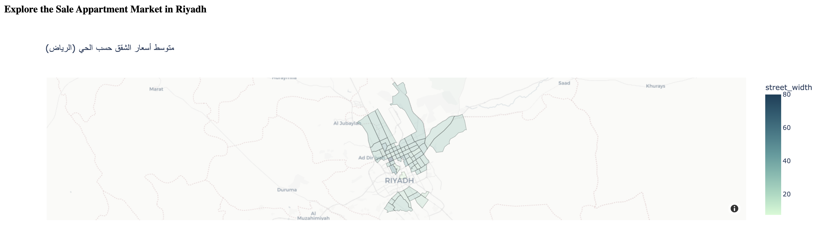

Utilizing analytics tools and machine learning reduces search time by up to 50%
Goal
Approach
Example
Gain insight into market
Develop analytical dashboard
Great deal! This apartment is listed at 10% lower than its fair value.
Narrow down option
Price fairness indicator

Slide 5
Executive summary
Motivation & goals
Deliverables
Data set
Analytics Dashboard
Deal Fairness Indicator
Future work
Challenges & limitations
Next steps

